Slide 1
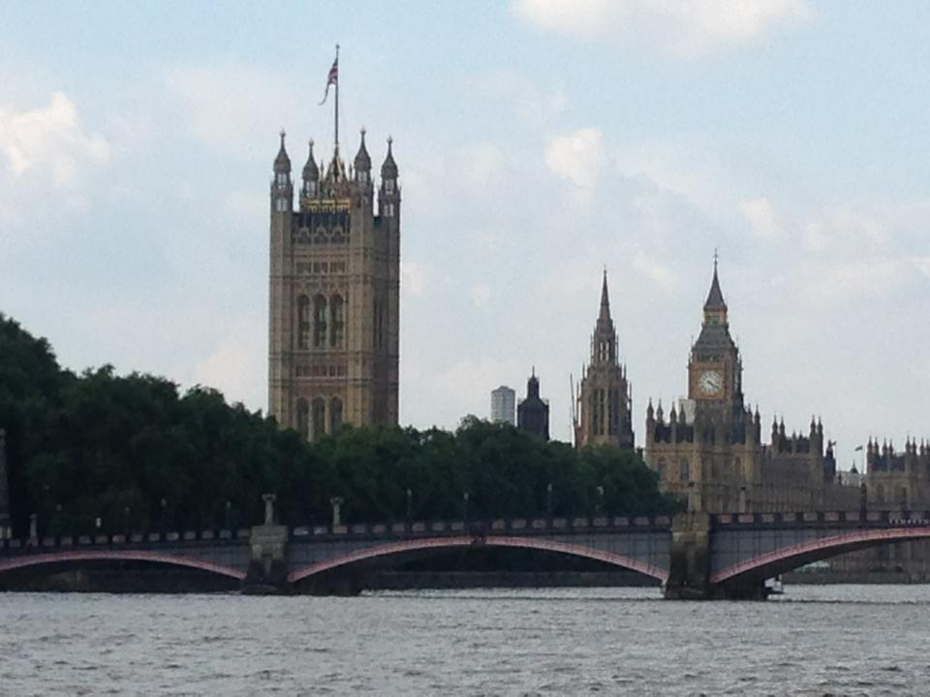
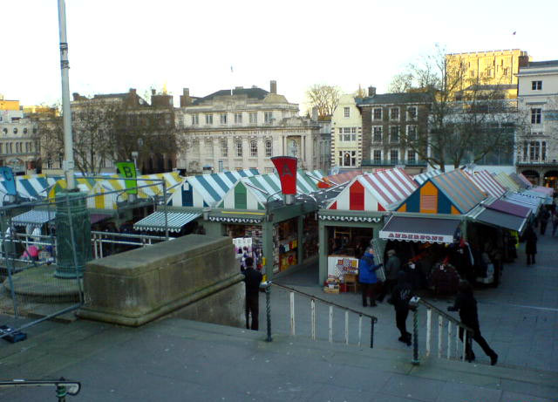

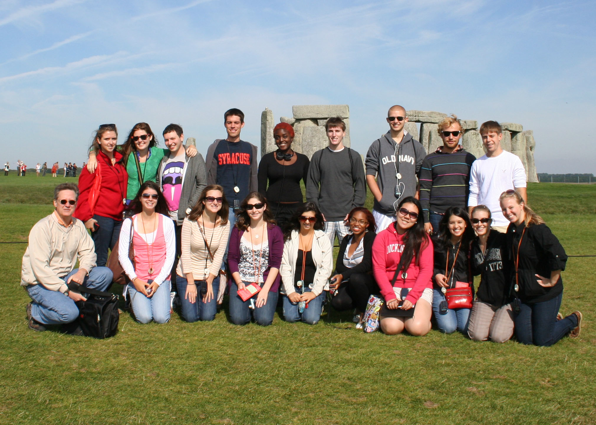
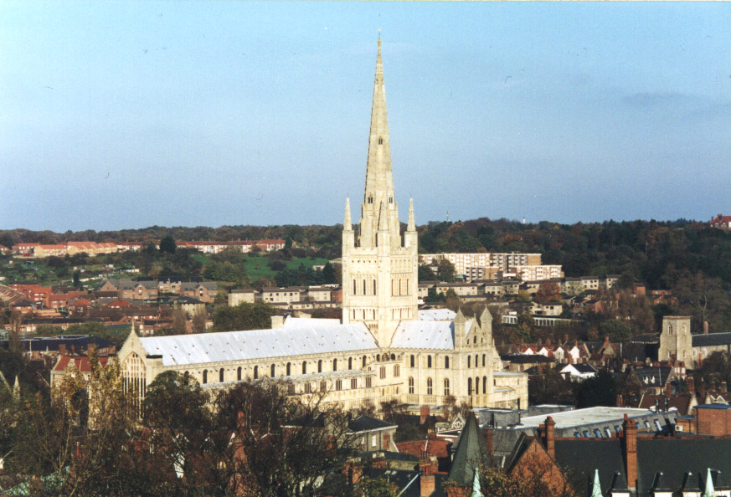
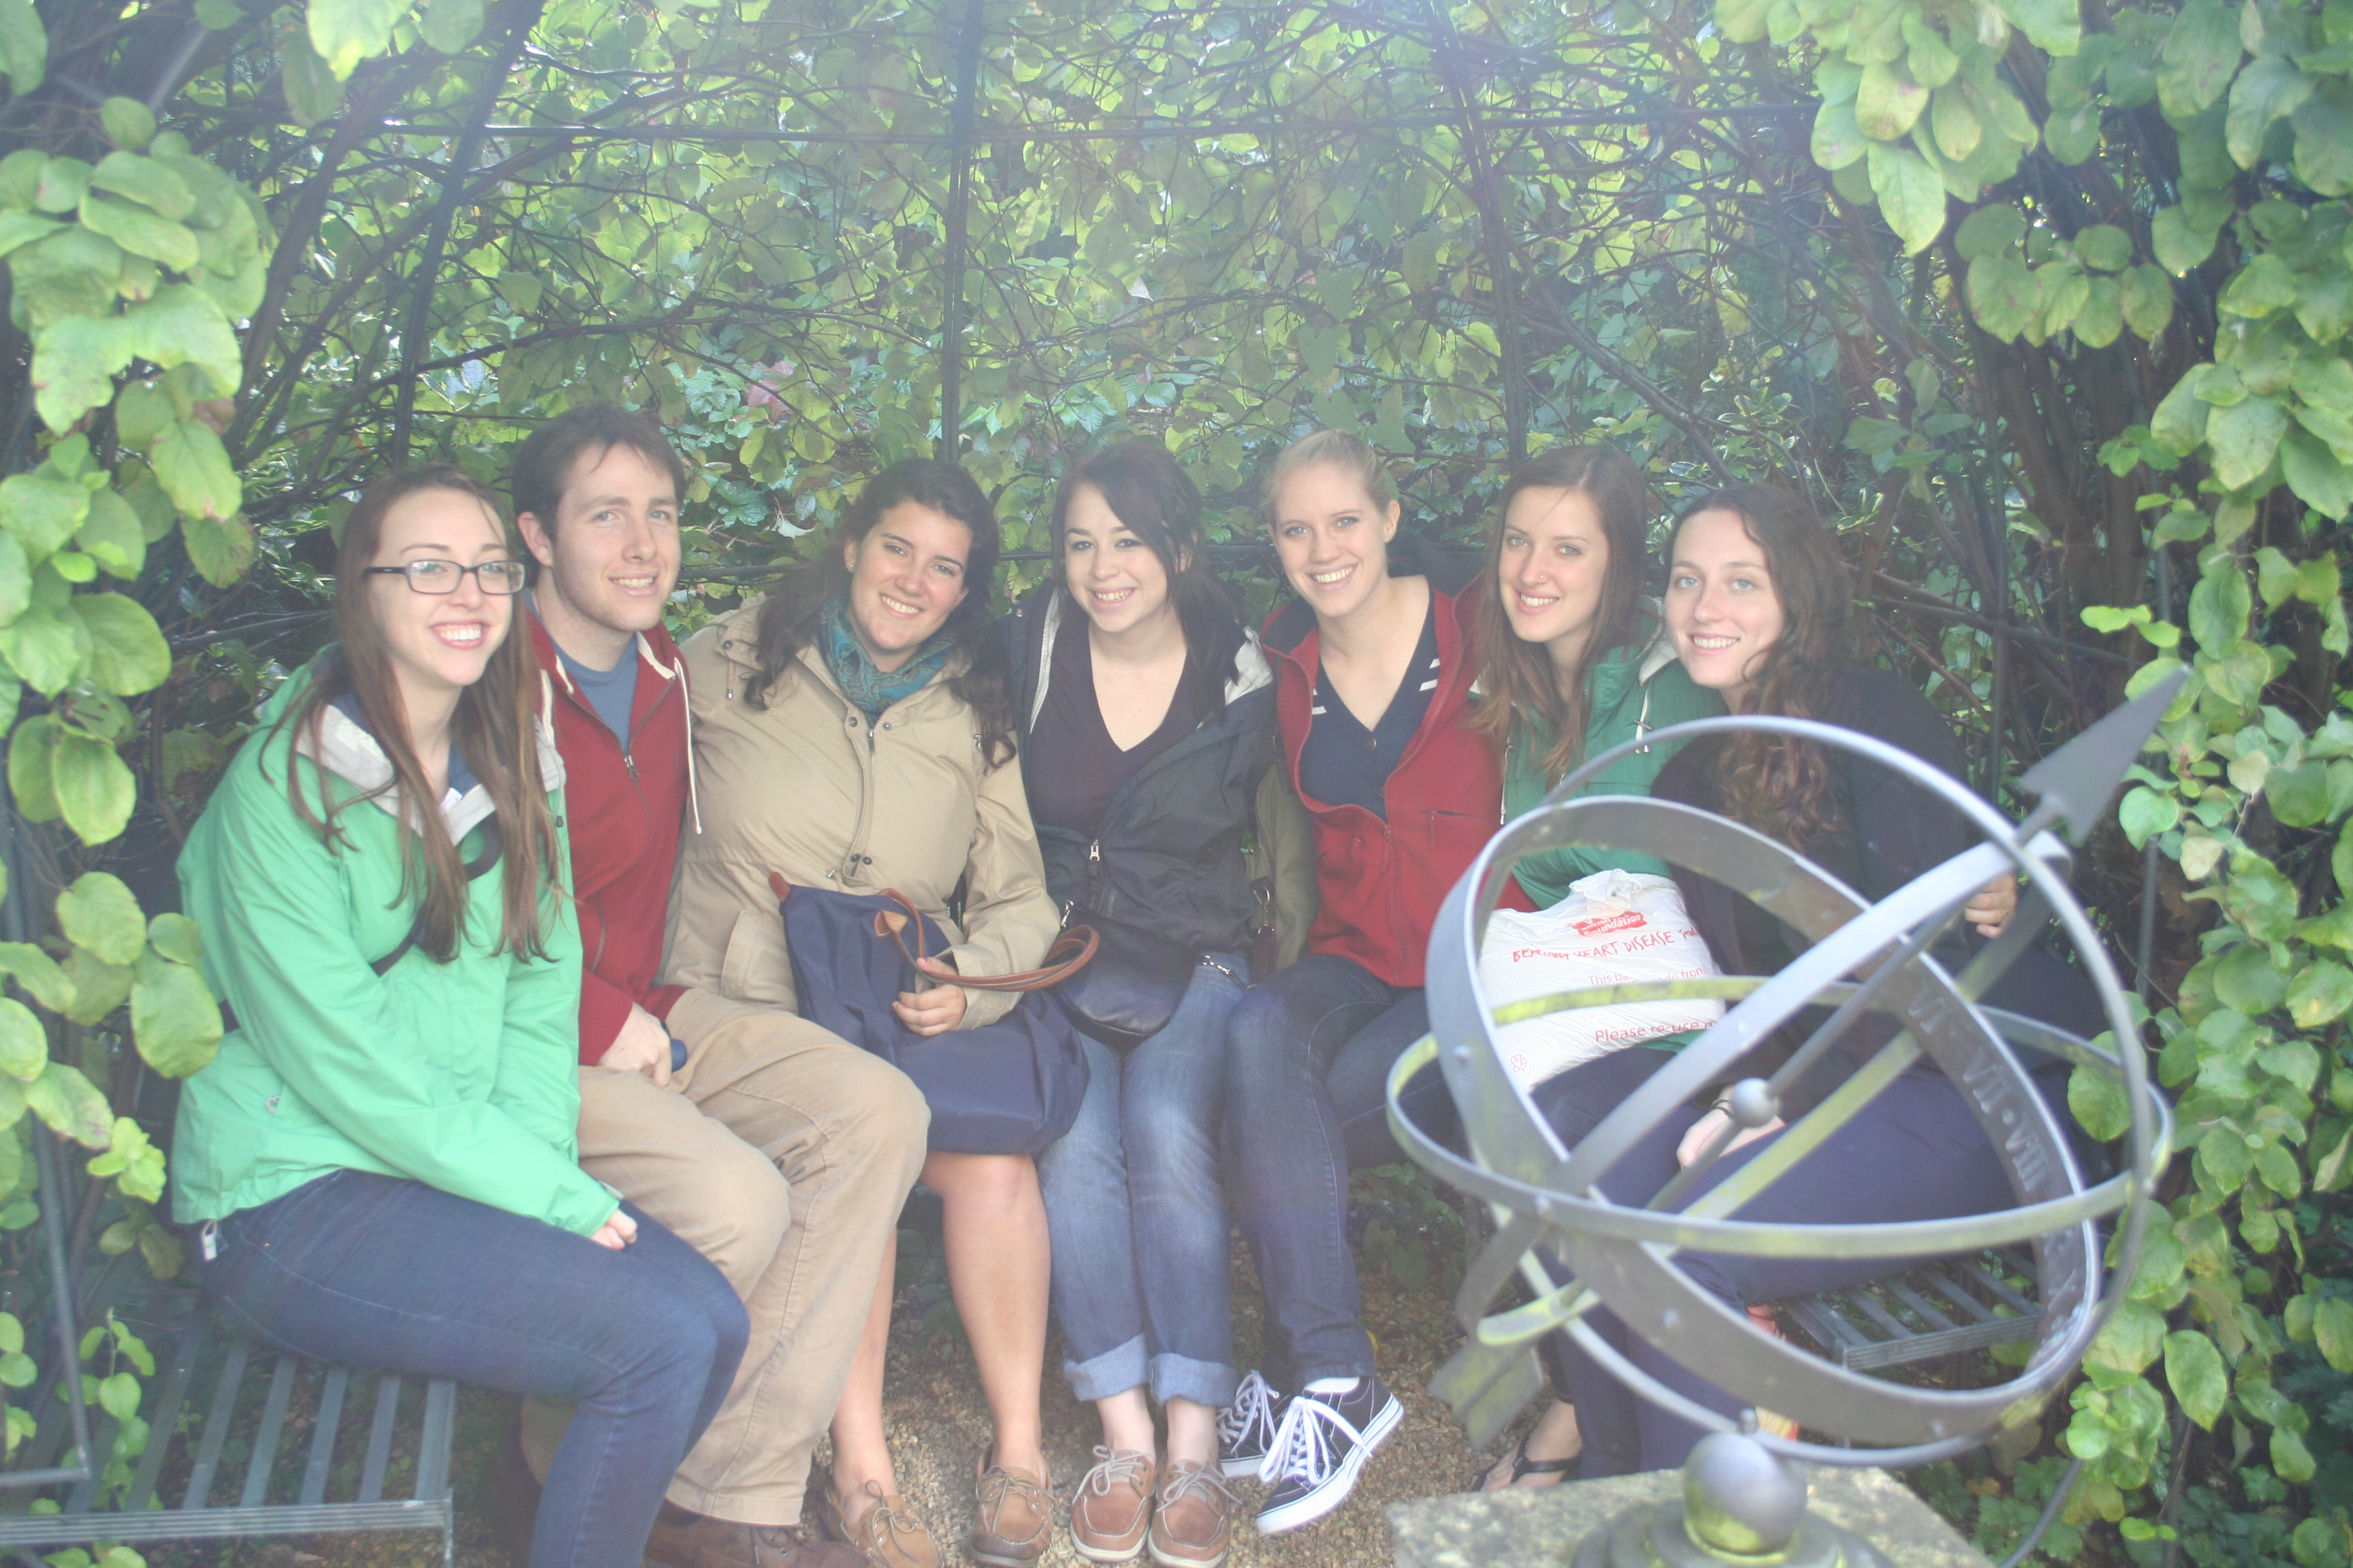
NORWICH SCIENCE INFO SESSIONS
For all year 2015-2016
For Fall 2015
You’re invited to attend either of the following
Thurs 10/2 noon-1p, Stafford Aud
Thurs 10/9 7-8p, Dana 202
For more info, contact CGSE (global@dickinson.edu)
or Prof. Kushner (kushnerd@dickinson.edu)

